Slide 1
NATO Reference Documents
Overall classification is NATO UNCLASSIFIED – RELEASEABLE TO efP
OF-3 John LANDERS, USA A
HQ Allied Land Command, G7

Slide 2
What are Lessons Learned?
History
Knowledge Management
Training Aid
Change Management
Planning Tool
Waste of Time?
Project Management Phase
After Action Activity
Best Practice
Notes:
Before I start with the NATO LL Reference Documents let‘s ask ourselves: What are Lessons Learned?

Slide 3
What are Lessons Learned?
Knowledge Management
Getting the right information to the right people at the right time
Change Management
Making sustainable, positive change in an organization
The purpose of a Lessons Learned procedure is to learn efficiently from experience and to provide validated justifications for amending the existing way of doing things, in order to improve performance, both during the course of an operation and for subsequent operations.
*AJP 3(B) Allied Doctrine for Joint Operation

Slide 4
MAIN DOCUMENTS
NATO LL Policy (September 2011)
Bi-SC Directive 080-006 Lesson Learned (February 2018)
ACO Directive 080-001 Lesson Learned (July 2013)
BI-SC Directive 075-003 Collective Training & Exercise (December 2014)
NATO Lessons Learned Handbook 3rd Edition (February 2016)
Joint Analysis Handbook 4th Edition (February 2016)
Notes:
The NATO LL Handbook is being updated this year.
Bi-SC (Bi-Lateral Strategic Command) – Allied Command Operations and Allied Command Transformation

Slide 5
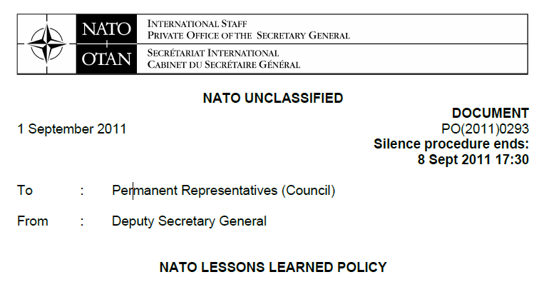
NATO Lessons Learned Policy
This document is the overarching policy governing Lessons Learned NATO wide and it describes:
The Policy Objectives
Applicability of the Policy
Lines of development
The NATO Lessons Learned process
Roles and responsibilities for LL in NATO
Implementation and Resources
Notes:
NATO LL Policy provides guidance to Bi-SC 080-006.
We will discuss the top two bullets in more detail in the following slides.

Slide 6
NATO Lessons Learned Policy
THE POLICY OBJECTIVES ARE:
To improve the effectiveness of political-military consultation and decision making, to facilitate the development of concepts and doctrine Alliance-wide, and contribute to the planning and conduct of current and future operations, along with capturing lessons at tactical level from ongoing operations.
To enhance security, Education, Training Exercise and Evaluation (ETEE) and experimentation, as well as managerial practices, including resource management, and public diplomacy thus supporting the continuing transformation of the Alliance.

Slide 7
NATO Lessons Learned Policy
APPLICABILITY:
All NATO bodies, agencies and staffs
Allies and non-NATO nations contributing to NATO-led operations and missions
The exchange of best practice and Lessons Learned with other international organisations on the respective organisations' operations, training and exercises, including on interoperability standards, within NAC-agreed policy guidance and based on the principle of reciprocity.

Slide 8
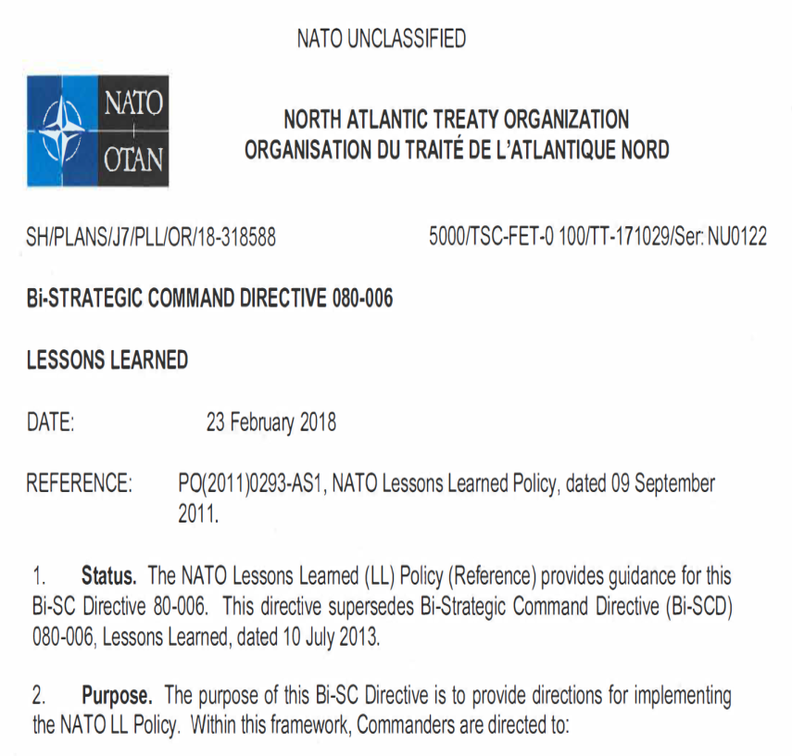
Bi-SC Directive 080-006 Lesson Learned
Purpose is to provide directions for implementing the NATO LL Policy.
Commanders are directed to:
-Develop, implement, and sustain
an effective LL capability in their
own organisation.
-Execute the NATO LL process and
use the NATO LL Portal to provide
transparency and accountability.
Notes:
It provides direction on implementing NATO LL Policy

Slide 9
Bi-SC Directive 080-006 Lesson Learned
It consist of 6 chapters:
INTRODUCTION
PURPOSE
KEY DEFINITIONS
THE LESSONS LEARNED CAPABILITY
ROLES & RESPONSIBILITIES
GUIDANCE FOR OTHER NATO BODIES, NATO COEs, ALLIES,
NON-NATO ORGANISATIONS AND PARTNERS
Notes:
It provides direction on implementing NATO LL Policy

Slide 10
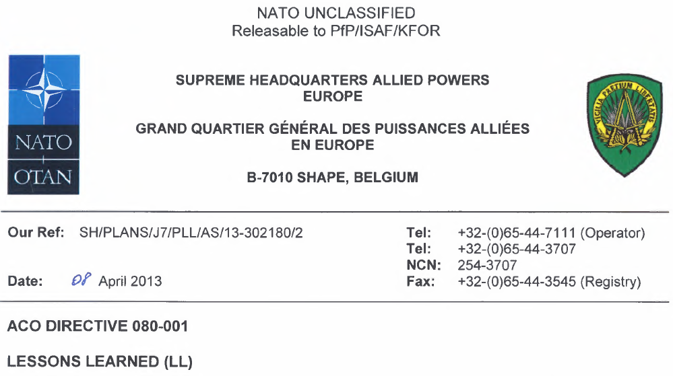
ACO Directive 080-001 Lesson Learned
This directive establishes a standardised and coordinated approach to the Lesson Learned (LL) process and details the task and responsibilities involved. It provides additional guidance and direction for the implementation of the LL process within ACO. It should be read in the context of Bi-SC Dir 080-006.
This directive is applicable
to SHAPE and all ACO HQs.

Slide 11
ACO Directive 080-001 Lesson Learned
It consists of 4 Chapters:
Introduction
Prioritized Analysis Requirements List (PARL) development
The lessons learned process within ACO
SHAPE handling of reports
Notes:
Commanders of ACO HQs are tasked to take ownership of the LL process in accordance with the NATO LL Policy and the Bi-SC LL Directive 80-6.
Consequently, commanders are to establish their own directives or SOP to run their internal LL process.

Slide 12
Bi-SC 075-003 CT&E Directive
This directive provided Bi-SC direction pertaining to the NATO military collective training and exercise process. It should be used as a comprehensive guideline on how to plan, execute and assess NATO collective training and military exercises to provide ready forces for current and future operations.
This directive is applicable to all NATO collective training and exercises. It can also be adapted for national and multinational exercises as appropriate.
Notes:
CT&E- Collective Training and Exercise
318 Pages

Slide 13
Bi-SC 075-003 CT&E Directive
It consists of 6 Chapters:
Introduction
The NATO Exercise Process
STAGE 1: Exercise Concept And Specification Development
STAGE 2: Exercise Planning And Product Development
STAGE 3: Exercise Operational Conduct
STAGE 4: Analysis And Reporting
Special attention to be paid to:
Chapter 6. Stage 4: Analysis and Reporting
Annex S Lessons Learned Process and Information Sharing in Collective Training and Exercises
Bi-SC Letter on EXERCISE REPORTING AND HANDLING LESSONS IN EXERCISES, May 2016
Notes:
CT&E- Collective Training and Exercise
318 Pages

Slide 14
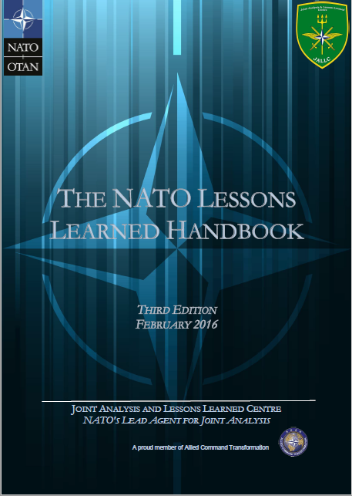
The NATO LL Handbook
3rd edition, February 2016
The purpose of this handbook is to guide and assist you in fulfilling your role in supporting your organization and NATO to effectively learn from experience.
NATO LL capability, process, and actors
Gathering Observations
Analysis – Observation to Lessons Identified
Staffing LI to LL
LL Information Sharing

Slide 15
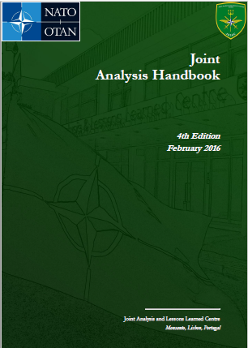
Joint Analysis Handbook
4th edition, February 2016
This handbook provides guidance on how to conduct analysis in support of Lessons Learned (LL) processes. It is primarily designed to assist Lessons Learned Analysis Staff Officers with all aspects of conducting analysis, both in the office and when deployed to operations, training events, exercises or experiments.
Introduction to Joint Analysis
Tools and Techniques for Joint Analysis

Slide 16
QUESTIONS

