Slide 1
Afghanistan Information Communications Technology (ICT) Way Ahead Strategy and Plan
James P. Craft (Deputy Director, C4, Headquarters Marine Corps), james.craft@usmc.mil
Al Johnson (ASD NII), al.johnson@osd.mil
Larry Wentz (NDU CTNSP), wentzl@ndu.edu
Bob Kinn (ASD NII), robert.kinn.ctr@osd.mil
Thomas A. O’Neil III, taoneil3@gmail.com
Oliver Dziggel, oliver.dziggel@bearingpoint.com
(version 1.2, 01/19/09)

Slide 2
Purpose
Highlight the importance of the Afghan ICT sector to US and Afghan strategic interests for security, stabilization and economic development
Reestablish US ICT train, advise and assist functions in Afghanistan
Recommend key strategic changes in the US engagement of the Afghan ICT sector based on experience and results

Slide 3
Key Recommendations
View and treat Afghan ICT as an “essential service”
  Support Afghan security and national unity
  Engine for Afghan social and economic development
  Support C4ISR needs
Reestablish US leadership in support of Afghan ICT
  Employ a senior ICT spokesperson with ICT and USG experience to
    Lead the USG ICT effort in Kabul
    Advise USG civil-military elements
    Deal with Afghan ICT counterparts
  Establish commercial ICT planning and consultation capability
    US Embassy and USAID
    USFOR-A (in Headquarters and in the field Civil Affairs Operations)
    ICT expertise at PRTs as appropriate
  Establish a US reach back capability to focus government and private sector support of the US Strategy to support Afghan ICT sector
Develop and implement a US Strategy and plan to support Afghan ICT
  Clearly articulated goals and measures, roles and responsibilities
  Review current and past efforts in the ICT sector to develop lessons learned
  Specific near, mid and long term actions with a portfolio of potential investments
  Leverage existing market forces and desire of the Afghan people for more ICT

Slide 4
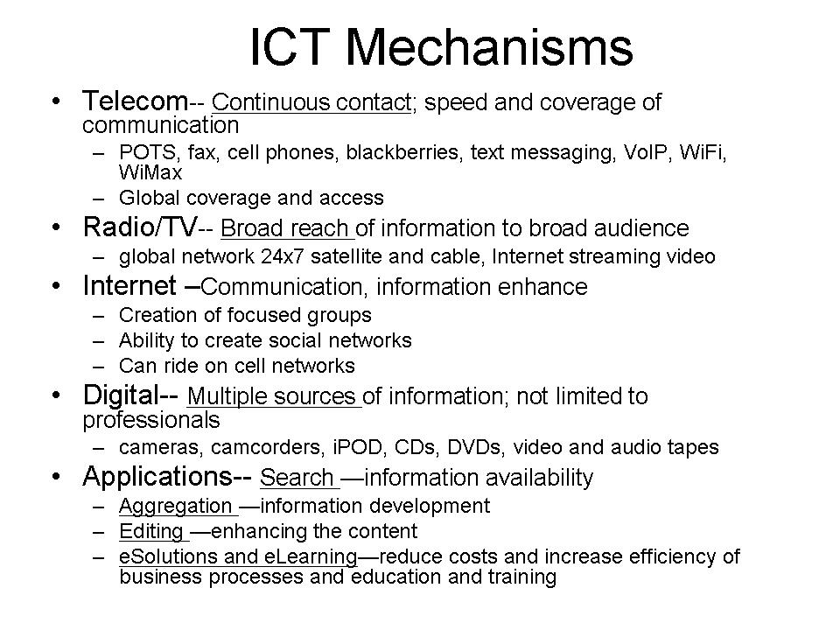
What is ICT?
Information Communications Technology (ICT) is the convergence of Telecommunications and traditional Information Technology.
  “the catch-all phrase used to describe a range of technologies for gathering, storing, retrieving, processing, analyzing and transmitting information.
  Includes the national communications infrastructure
Advances in ICT have progressively reduced the costs of managing information, enabling individuals and organizations to undertake information-related tasks much more efficiently, and to introduce innovations in products, processes and organizational structures.” – Government of Australia, Smart State Strategy.

Slide 5
Why focus on ICT in Afghanistan?
Can empower/accelerate success in all reconstruction efforts (e.g., security, governance, education and distance learning, healthcare, agriculture, and finance).
Gives situational awareness that can save lives.
Has demonstrated that it is one of the best generators of jobs and revenues
Provides transparency to help reduce corruption and enhance government legitimacy
ICT allows us to positively influence attitudes of the Afghan leaders and general population to help transform Afghanistan from a collection of tribes into a nation
ICT is a strength for the US; we can and should demonstrate leadership
Peer international ICT competitors to US interests and influence (e.g., China, India and Iran) are filling gaps left by US lack of attention

Slide 6
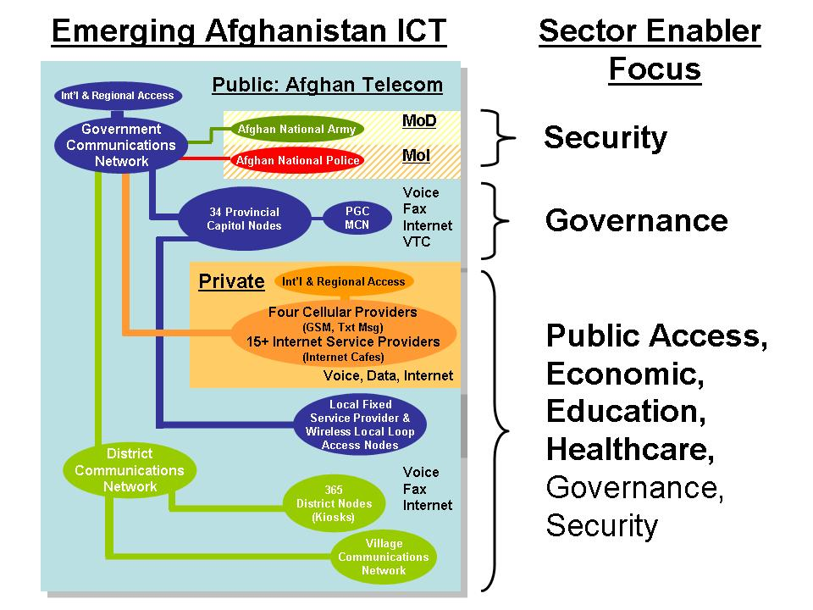
ICT as Sector Enabler

Slide 7

Current ICT-Related Stakeholders
Afghan Stakeholders
US Embassy
ECON/EWG
ICMAG (S/CRS)
PRT Cell
USAID
US Military Elements
ISAF
USFOR-A
CJTF-101/CSTC-A
USACE
BCTs (COIN)
MCIT/ATRA
Afghan Telecom
(ZTE-Fiber, WLL providers)
4-GSM providers
ISPs
Ministries
Other Public and Private Sector
Afghan Public
DSE-A
PRTs
Afghanistan
CONUS
DoS
Afghan Desk
HIU
S/CRS: Afghan
Engagement Group
USAID: Afghan Desk,
EGAT/ICT, and
OMA: CENTCOM
Liaison
DoD
ASD NNI IIS: Afghan AO
Joint Staff: Afghan Desk
CENTCOM: Afghan
Desk, DISA-CENT,
USAID LNO
DISA: Contingency Ops
USACE, Services
NSC: Afghan
Steering Group
US Industry and NGOs
NDU
CTNSP
INSS
NESA
IRMC
Afghan-American Community
The Key to Success is Relationships between People and Organizations

Slide 8
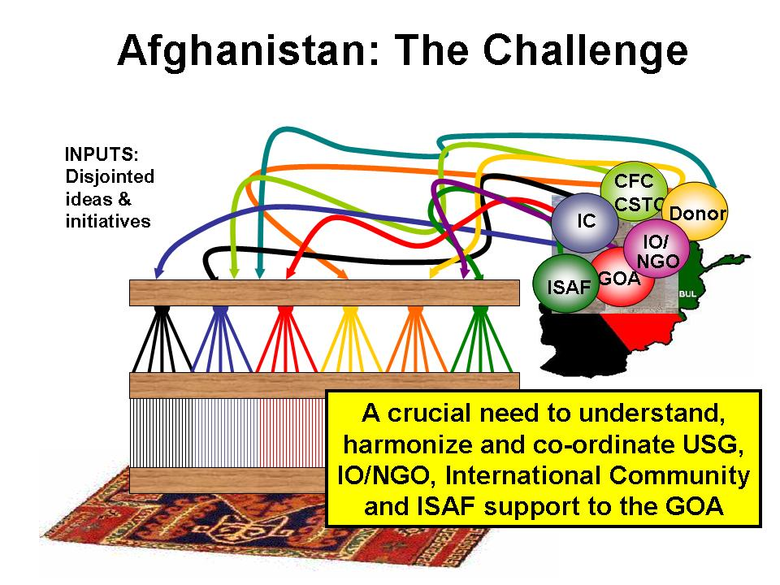
USFOR-A
USAID
DoS
Lack a USG and International ICT strategy and plan for enabling
affected nation and agreed mechanisms for enabling
collaboration and information sharing. No senior USG ICT leadership.

Slide 9
Providing US ICT Leadership
Afghan Stakeholders
US Embassy
ECON/EWG
ICMAG (S/CRS)
PRT Cell
USAID
US Military Elements
ISAF
USFOR-A
CJTF-101/CSTC-A
USACE
BCTs (COIN)
MCIT/ATRA
Afghan Telecom
(ZTE-Fiber, WLL providers)
4-GSM providers
ISPs
Ministries
Other Public and Private Sector
Afghan Public
DSE-A
PRTs
Proposed
US ICT Lead
Proposed Military ICT Support
Afghanistan
CONUS
DoS
Afghan Desk
HIU
S/CRS: Afghan
Engagement Group
USAID: Afghan Desk,
EGAT/ICT, and
OMA: CENTCOM
Liaison
DoD
ASD NNI IIS: Afghan AO
Joint Staff: Afghan Desk
CENTCOM: Afghan
Desk, DISA-CENT,
USAID LNO
DISA: Contingency Ops
USACE, Services
NSC: Afghan
Steering Group
US Industry and NGOs
NDU
CTNSP
INSS
NESA
IRMC
Afghan-American Community
Proposed US ICT Lead would manage complexity and focus effort

Slide 10
Way Ahead
US country team and military designate and treat ICT as an “Essential Service”
Reestablish US leadership in Afghan ICT
  Provide an Afghan ICT spokesperson in Kabul to
    Advise USG civil and military elements
    Rebuild partnerships with Afghan ICT counterparts
    Represent USG on ICT matters
  Establish a commercial ICT planning and consultation cell to support
    Modernization of Afghan ICT infrastructure and services—enable cross-sector reconstruction
    Security and reconstruction initiatives
    US military C4ISR infrastructure and service needs
  Develop a USG and Private Sector US Reach Back organization
  Identify opportunities for US ICT businesses to contribute
Develop a US Afghan ICT strategy and plan that supports the ANDS ICT strategy
  Creating a robust National ICT backbone infrastructure
    Fiber and other terrestrial communications
    International broadband access
    Establish a provisioning and network management capability
  Establishing Afghan Telecom as a viable and functional organization near term and ultimately privatize
  Extension of ICT services to rural areas
  Use of ICT to support governance, security, commerce, finance, education, and healthcare
  Improving cyber security and critical infrastructure protection
  Creating a CIO culture
  Improving nationwide data services and introducing use of e-Solutions for governance, healthcare and education

Slide 11
Afghanistan ICT: Opportunities
Enhance Network Robustness, Capacity, Coverage and Regional and Int’l Access
Expand Network Capacity and Internet Capacity
Emergency ICT: Embed Protected Services (US NCS-like) in GCN, DCN, & Cell Nets and Interoperable Communications Capabilities
Sector
GCN
DCN
ANA
ANP
Cellular
ISP
Extend to Police
Security
Voice, Fax, Cell, VTC,
Internet, Sat Phone,
Tactical Radio
Establish a Nation-wide ISP
Implement PGC and MCN
Internet Access
Voice, Fax,
Internet,
VTC
CDMA WLL
LFSP
Pay Phones
GSM
US strategy, plan, and portfolio drives to specific coordinated investments for measured results in support of the Afghan ICT Strategy and USG reconstruction and stability efforts
Extend Access to District Leaders and Police
Governance
Ministries Introduce eGovernment and CIO-like Culture
Priority Call Access for Emergency Services
Internet Access
Public
Voice, Fax,
Internet
Telekiosks
Extend to Rural Areas (VCN) and Improve Marketing and Access to Services (Telekiosks)
Expand Coverage (CDMA WLL & LFSP) and Add Data and Internet Services
GSM
and
PCO
Internet Access
and
Internet Cafes
CDMA WLL
Private
Introduce eSolutions and CIO-like Culture
CDMA WLL
Expand Capacity and Coverage and Add Data Services
Internet Access
Health &
Education
Expand Coverage and Cross-Sector Access and Extend to Rural Areas
Establish National Cyber Security Strategy and Plan
Additional Use
Opportunities
Current Use
Create Robust
National ICT Backbone

Slide 12
Next Steps
Brief USG Senior Leaders and Stakeholders and Obtain Support
Identify Qualified Candidate for USG ICT Lead for Afghanistan
Develop for USG strategy and Engagement Plan, Identify Key Initial Investments
Socialize USG Support with Afghan Leadership
Allocate initial staff and resources to support USG ICT Strategy, Plan, and Investment Portfolio

Slide 13
Backup Slides

Slide 14
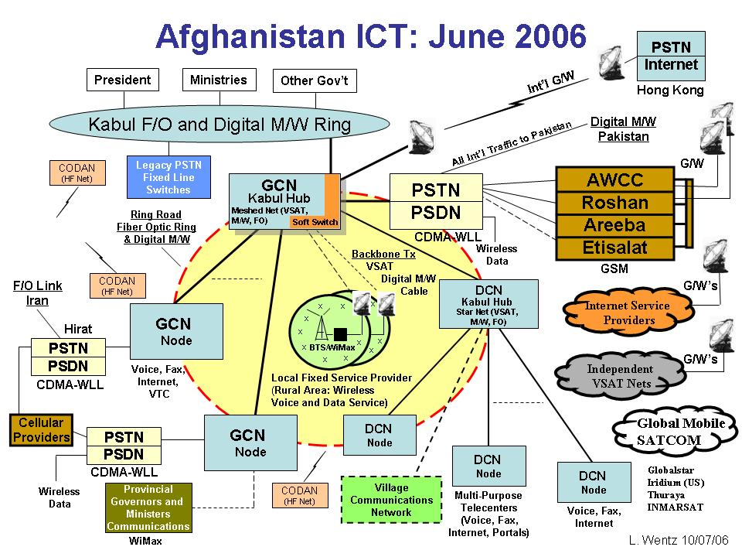
Afghan ICT Sector
Planned and Initial Implementation In-Progress
Afghan Telecom
Private Sector

Slide 15
ICT-related Challenges
Pervasive lack understanding of information culture and ICT business culture
  There is no USG ICT business model for intervention, reconstruction and development
  Key decision makers are not knowledgeable of the potential benefits and limitations of ICT
ICT has not been viewed or treated consistently as an “essential service”
  Integrate ICT into strategic communications strategy and plan
  Past successes have been used as an argument for US disengagement
  There is no agreed, coherent USG (or international) strategy, plan, and approach for supporting Afghan ICT reconstruction, development, and capacity building
  Program development, project coordination, information sharing, ICT implementation and capacity building are largely ad hoc, uncoordinated and non-standard
There is an absence of senior US commercial ICT professional leadership and forward deployed commercial ICT assessment, planning, and consultation capability to advise and support USG civil-military elements and work with Afghan ICT counterparts
  Lack of physical, personal, and cyber security investments
  Lack of consistent relationship building between ICT stakeholders and US leadership
  Need to manage expectations, ours and the Afghans
USG security protection measures for reconstruction are risk averse not enabling

Slide 16
Afghan ICT Short Falls
Network fragile and performance marginal
No national backbone and limited broadband service
Lack rural area coverage
Limited terrestrial infrastructure and international access
Lack adequate support to governance, security, commerce, financial, education and healthcare
Lack adequate cyber security and physical protection
Lack CIO and Cyber Security culture
Lack nationwide and ministry-wide data strategy and IT services
Lack implementation of e-Solutions
Thin layer of ICT and IT competence and business operations, marketing, management and technical skills
Afghan Telecom not a viable and functional organization
Lack reliable power
Lack an ICT baseline of activities and gaps and mechanism for collaboration and sharing information among stakeholders and visualizing actions and impacts

Slide 17
Afghanistan ICT Support History
Background: When the US re-established the US embassy in Kabul a NSC memorandum established the Afghanistan Reconstruction Group (ARG) composed of senior advisors drawn from private industry. The ARG fostered and coordinated a number of successful initiatives (many that predated the ARG). That coordination and the creation of new initiatives contributed greatly to the initial progress in Afghanistan.
  In September 2005 after the position had been vacant for two years, the ARG’s first senior telecommunications advisor (STA) arrived in Kabul. He quickly established an ICT Integration Team (ICT I-team) in Afghanistan composed of State, DOD, USAID, the Afghan Ministry of Communications, selected industry members, and others. Additionally, with the support of ASD NII, he also formed focused government and private sector reachback groups to provide support to Afghanistan and to welcome visiting Afghan officials. These groups developed and coordinated a portfolio of initiatives (such as the building of the Provincial Governors Communications System, the formation of the National ICT Association of Afghanistan, training for government employees such as spectrum managers, attracting new Telecommunications companies, etc.) which brought a number of dramatic and measurable achievements, such as the doubling of cell phone users in one year, creation of over 20K technical jobs for the local population, and $120M into the government coffers in fees.
  Perhaps because of these successes, Department of State’s disinterest in technology matters, and the desire to move to “business as usual”
    US eventually dismantled the ARG, eliminated the STA position and the ICT I-team
    Senior Afghan officials and community leaders, feeling abandoned by the US have
      Begun to look to other nations for support (e.g., Iran, China, India, etc.)
      Expressed concern to visiting senior USG leaders and teams about apparent US disinterest
    The progress in ICT modernization and growth has begun to slow
    US is loosing the opportunity to shape and leverage an expanding national communications backbone.

Slide 18
Afghanistan Senior Telecom Advisor
Historical ICT Sector Engagement
Summary of significant areas of ICT sector engagement, reflecting initiatives of STA position and complementary support provided by ASD NII/ NDU
  NETWORKS:
    GCN; advisory and logistical support, coordinated between CFC, ASD NII, NDU and STA.
    PGCN; created by CFC & NII, coordinated with STA, 2 rounds CERP from CFC, CJTF-82, 19 province sites deployed.
    DCN; advisory and logistical support, coordinated between US commands, STA, NII.
    VCN; created by Minister, drawing upon STA’s USG efforts to create ‘Afghan Digital Solar Village’.
    OFC; ASD NII & STA civil advice provided to 2008, advice re military use 2008-2009
  ASSOCIATIONS:
    AFCEA; Afghan Chapter created by STA, ASD NII, NDU, US commands.
    NICTAA; National ICT Association of Afghanistan created with Western advisory group including STA, ASD NII.
  OTHER SOCIAL NETWORKING INITIATIVES:
    “I-Team” (ICT Integration Team), inter-agency group created by STA, with support from US commands, ASD NII and NDU.
      Included active inter-agency participation from Embassy State, USAID.
      Included sector expert advisors from Bearing Point, GlobeComm Systems, others with ICT sector interest.
  PROGRAMS/ PROJECTS:
    National Data Center; development of Center coordinated by STA with Minister of Communications.
    Commercial Cell Towers & FOBs; STA coordination between US commands, PRTs, Ministry, GSM operators.
    ICT sector capacity development; ongoing STA efforts with Ministry & Afghan Telecom to improve processes.
    Advisory role; creation of associations, Afghan approach to privatization of Afghan Telecom.
    Regional development; coordination with USG, regional governments & ministries on regional ICT development.
    ADSV (Afghan Digital Solar Village) vision of STA set foundation for Afghan development of VCN.

Slide 19
Afghanistan ICT Coordination Relationships (I-Team): June 2006
US Embassy
Senior Telecoms Advisor
Mr Jim Craft
Primary Advisor
Policy
Branch
Ministry of Communications
Minister Sangin
Liaison/Advisor
ECON
R Harris
USAID
Lane smith
Liaison/Advisor
Afghan TELECOM
Chief Executive
Mr Noorzai
Execution of
Telecom
CFC-A CJ6
MoC Liaison Officer
LTC Aaron Johnson
Liaison/Advisor
Liaison
US Embassy
USAID
DoD
BearingPoint
Oliver Dziggel
GSI
Tom O’Neil
CFC-A CJ9
Capt Verastegui
Ministry of Defense
Afghan National Army G6
MG Ali
Primary Advisor
CSTC-A CJ6
Chief of Comms
CDR Jack Steiner
MAJ David Lee
LtCdr Bill Howell
US I-Team
(met several
times a
Month)
Ministry of Foreign Affairs
Chief of Comms
Mr Fowad Moslim
Coordination/Training
Coordination
MoC I-Team
created but
never really
became
operational
Reachback
USG
Industry
German Police
Project Office
(GPPO)
Police Capt Pankok
Ministry of Interior
Chief of Comms
BG Hashimi
DoD Afghanistan
Reachback
Office

Slide 20
Near Term ICT Actions (3-6 months)
Start to develop an ICT baseline of activities and gaps and implement mechanism for collaboration and sharing information among stakeholders and visualizing and tracking actions and impacts
Support USFOR-A C4ISR
  Terrestrial connectivity
    Fiber
    International access
  Cellular network services
    Emergency communications
Rural area ICT
  Scaled down DCN nodes for VCN, ADSV-like solutions, Jbad Synergy Net model, STAR-TIDES solution sets, ITU village phone model, ..
  Community towers, towers on FoBs
  Incentives for private sector expansion or other providers
Governance, security, commerce, education and healthcare ICT
  Scaled down DCN nodes, Jbad Synergy Net model, …
  Extension of GCN and DCN service access
  Use of cellular network for nationwide telehealth network
    US Army Medical Research and Materiel Command proposal
  Private sector provider options
Explore means to improve viability of Afghan Telecom
Strategy and plan to support MCIT 5-year plan

Slide 21
Mid-Term Actions (1-2 years)
Support USFOR-A C4ISR and counterinsurgency
  Terrestrial connectivity
    Fiber
    International access
  BCTs and PRTs use of ICT as part of initiative packages
National ICT backbone and international access
Rural area ICT support and services
Strategy and plan to improve nationwide data services and ministry-wide use of e-Solutions
Ministry CIO training
  Engage NDU IRMC to train Afghan Ministry CIOs
Expanded use of cellular functionality, e.g., financial transactions (MPESA pilot), healthcare services, crisis response services, strategic communications, … and use of Internet for e-Banking and other sector service needs
Privatization of Afghan Telecom
Cyber Security and Critical Infrastructure Protection strategy and plan
Explore the use of STAR-TIDES as a means to identify and test ICT solutions for extension of ICT to rural areas and enabling other sectors
Explore e-Solutions for governance, education, and healthcare
Develop specific support to MCIT 5-year plan

Slide 22
Long Term Actions (beyond 2 years)
National ICT backbone and international access
  Fiber ring, digital microwave, WiMax, other
  Provisioning and network management
  International broadband access
    Fiber
Cyber Security and Critical Infrastructure Protection
Improved nationwide data services and ministry-wide use of e-Solutions
Expanded use of cellular functionality, e.g., financial transactions, healthcare services, crisis response services, strategic communications, … and use of Internet functionality and services
CIO and Cyber Security culture
National data center

