Slide 1
Introduction to NATO LL Capability and LL Process
OVERALL CLASSIFICATION OF THIS BRIEFING IS
NATO UNCLASSIFIED – RELEASEABLE TO eFP
OF-4 Steffen Roechow, DEU AF
G7, Chief Lessons Learned

Slide 2
AGENDA
1. LL capability
LL process
LL tools
LL structure
LL training

Slide 3
AGENDA
1. LL capability
LL process
LL tools
LL structure
LL training

Slide 4
Lessons Learned Capability
“A Lessons Learned capability provides a commander with the structure, processes and tools necessary to observe, analyse and take remedial action on any issue and to communicate and share results to achieve improvement.”
Bi-SCD 080-006, 10 July 2013
Notes:
According to the Bi-SC Directive 080-006, this is the definition of a LL Capability.
This definition encompasses the two phases of the NATO LL process as well as the important information sharing aspect IOT achieve the desired improvement.
Be aware that every command in the Bi-SC organization is directed to establish and sustain a Lessons Learned (LL) capability and to execute the Lessons Learned process for the benefit of NATO and of its own organization.

Slide 5
EFFECT OF LESSONS
Routine Training
Pre-deployment Training
In-theatre Training
Lesson
Situational Awareness
Tactical Preparation
Operational Planning
Urgent Kit Requirements
Mid-term Equipment Procurement
Long Term Capability Requirements
Short Term Reactive Change
Long Term Proactive Change

Slide 6
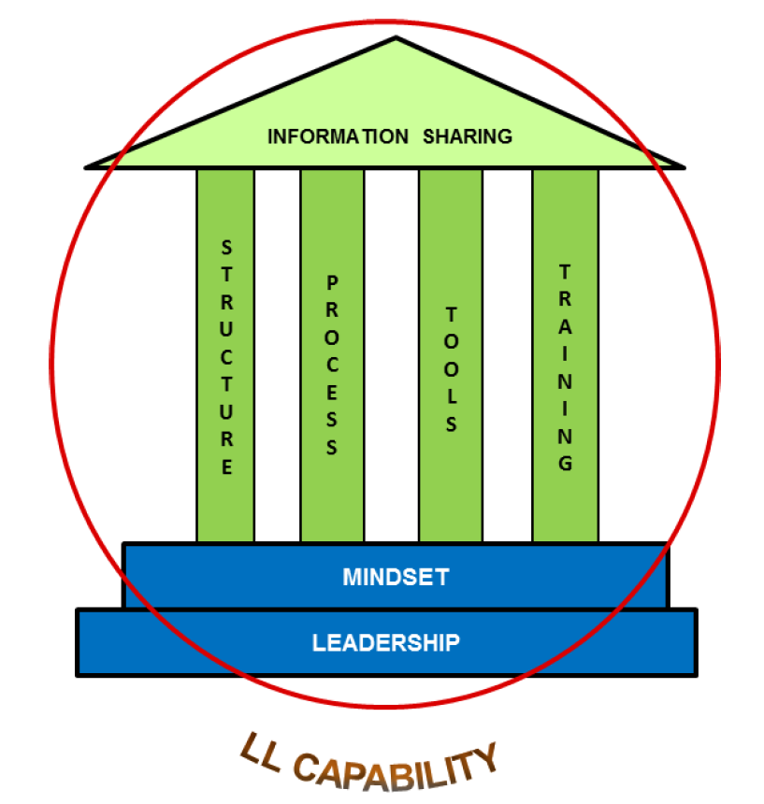
NATO LL Capability
Lessons Learned Capability
Bi-SCD 080-006, 23 Feb 2018
Notes:
6
This slide summarises the NATO LL Capability as stated in the Bi-Strategic Command Directive 080-006, “Lessons Learned”.
The key elements of a LL capability are:
Structure - Skilled and dedicated LL personnel allocated to adequate posts within the organization,
Process - A common LL process for developing a lesson, to include sharing and utilizing it appropriately, and
Tools - Technological tools to facilitate an effective process, such as the NATO LL Portal.
Some critical success factors that influence the effectiveness of a LL capability are:
Senior Leadership engagement,
A Mindset based on desire to improve and willingness to share,
Information sharing, with emphasis on the “responsibility to share”, and
Stakeholder involvement, i.e. involving stakeholders affected by a problem is essential in ensuring the problem is appropriately addressed

Slide 7
Capability Requirements
Tangible Requirements
High level Directive
Unit level SOP
Methods for capturing Observations
Resources for analysis
Procedures to endorse and implement lessons
Software tools to share and track lessons
Intangible Requirements
Leadership engagement
Positive learning mindset
Self-critical approach to business
Stakeholder involvement at all levels
Training and Education
Quality Observations and Analysis
Notes:
Here are some examples for capability requirements covering the three key elements structure, process and tools.
These are divided into tangible and intangible requirements.
Tangible: palpable, perceptible, concrete, physical, solid
Intangible: imperceptible, impalpable (unclear)

Slide 8
AGENDA
1. LL capability
LL process
LL tools
LL structure
LL training

Slide 9
LESSONS LEARNED PROCESS
“The purpose of a Lessons Learned procedure is to learn efficiently from experience and to provide validated justifications for amending the existing way of doing things, in order to improve performance, both during the course of an operation and for subsequent operations.”
AJP 3(B) Allied Doctrine for Joint Operations
Notes:
This brings me to the 2nd part of my presentation, the NATO LL Process.
Acc. to AJP 3(B) Allied Doctrine for Joint Operations
Key points are highlighted:
to learn efficiently
to provide validated justifications
to improve performance [nowadays, and]
for subsequent operations

Slide 10
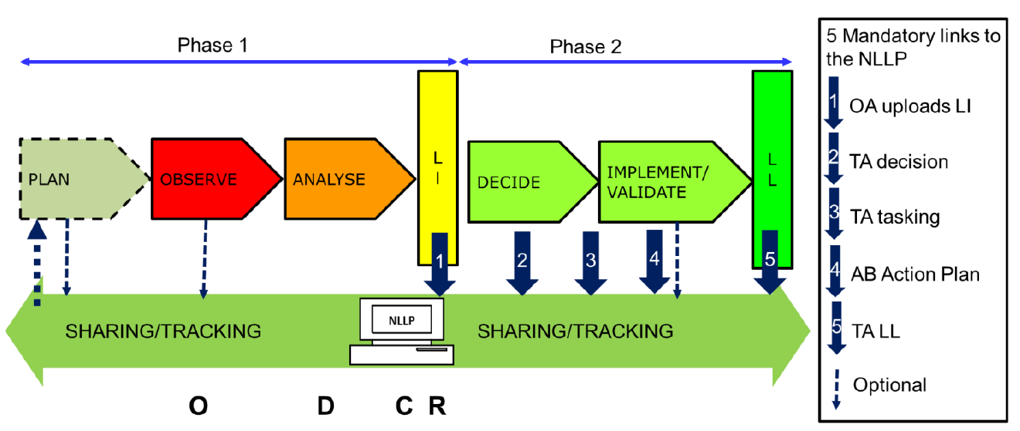
NATO Lessons Learned Process
Bi-SCD 080-006, 23 Feb 2018
Notes:
This illustration depicts the generic NATO LL Process as it is stated in the Bi-Strategic Command Directive 080-006, “Lessons Learned”.
On the following slide I will use an animated version with a slightly different design but same content for practical purposes only.

Slide 11
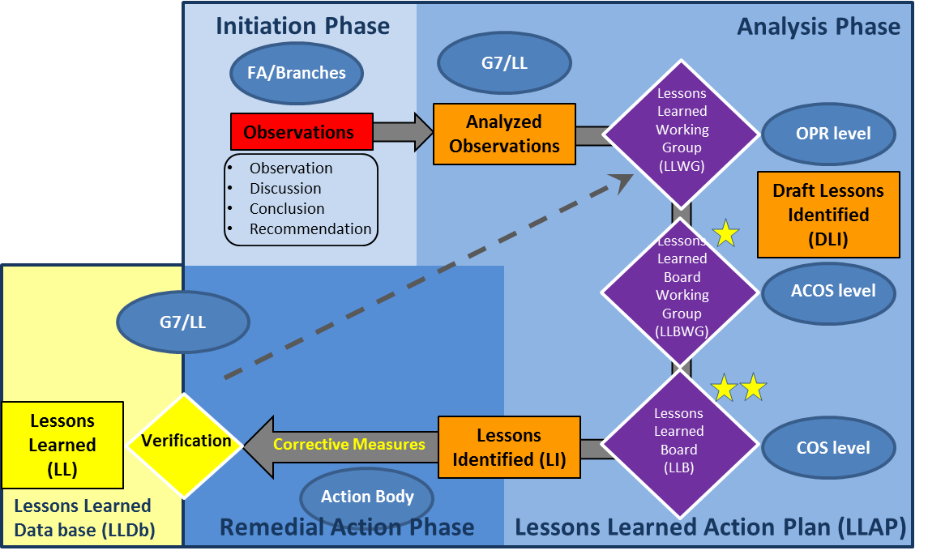
LC LL process
LL WG held at OPR-level, chaired by the Section Head LL.
Discuss, prioritize the analyzed observations, their Remedial Action and their Action Body
LL Board chaired by COS
For submission
Notes:
LL WG has meetings on a regular base
The LLWG is held at OPR-level. Its aim is to discuss and prioritize the analyzed observations, their associated Remedial Action (RA) and Action Body (AB).
After the LLWG, G7LL prepare the finalized list of (key) Draft Lessons Identified (DLI) for submission to the COS.

Slide 12
Critical Success Factors
Leadership Engagement
Stakeholder Involvement
Information Assurance
Notes:
I want to talk a little bit more in detail about some critical success factors to the success (or failure) of the NATO LL process.
In November 2010 the JALLC published a report on “The Lessons Learned Process and Lesson Sharing in NATO and Nations”.
Three Critical Success Factors were identified, which were
Leadership Engagement, Stakeholder Involvement and Information Assurance.
I will highlight the different factors in more detail on the following slides.

Slide 13

Leadership Engagement
Lessons Learned is a Command responsibility
Risk/Resource consideration for RA
Support to LLSOs
Endorsing internal lessons
Committing to sharing lessons out
Endorsing external lessons
Notes:
Let’s start with leadership engagement.
Explain each bullet point in detail.

Slide 14
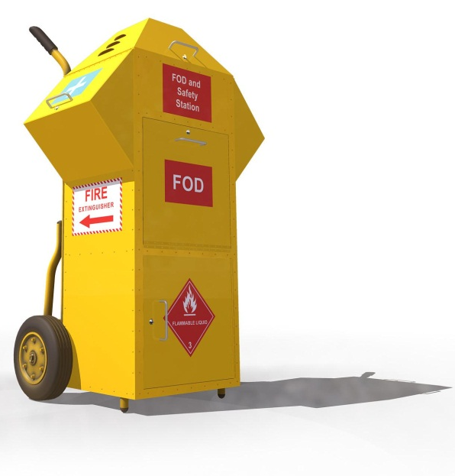
Stakeholder Involvement
LL involves everyone,
it is like Flight-Line Safety
Each level adds value,
like the Orders process
LL is personality driven or personality stalled
Notes:
Explain each bullet point in detail.

Slide 15

Information Assurance
The Observation establishes the Business Case for change
The quality of the analysis determines Command support and resourcing
Lessons for sharing must be authoritative
Notes:
Explain each bullet point in detail

Slide 16
AGENDA
1. LL capability
LL process
LL tools
LL structure
LL training

Slide 17
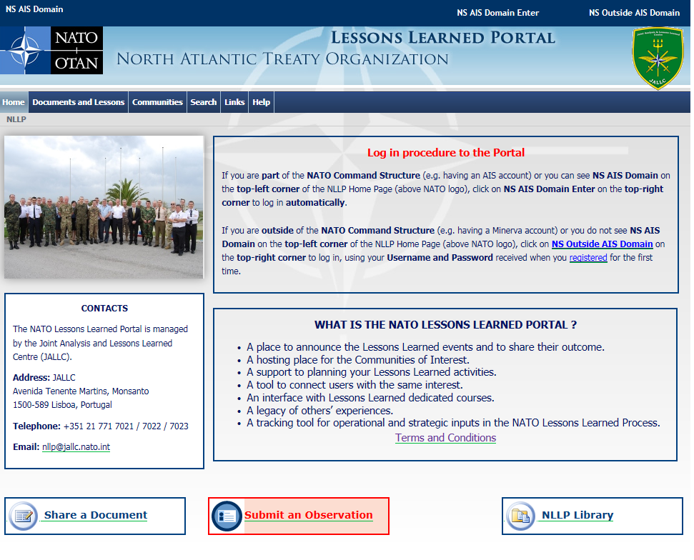
NATO LL PORTAL

Slide 18
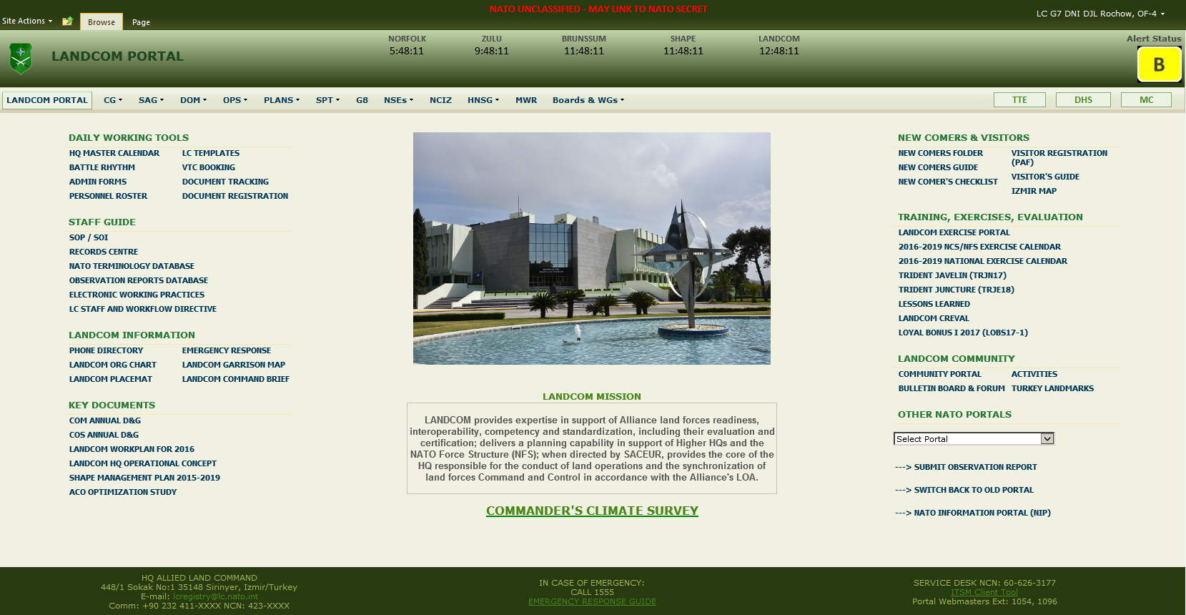
LESSONS LEARNED

Slide 19
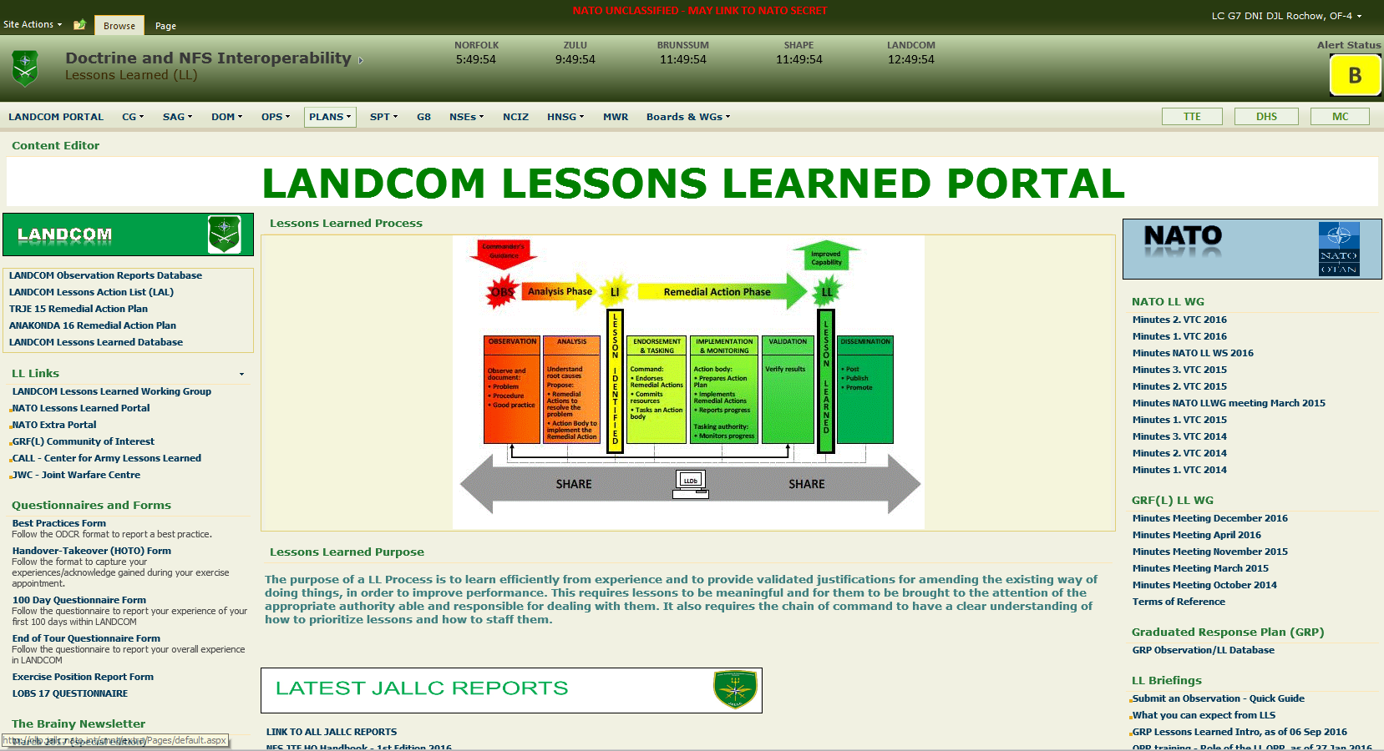
LESSONS LEARNED

Slide 20
AGENDA
1. LL capability
LL process
LL tools
LL structure
LL training

Slide 21
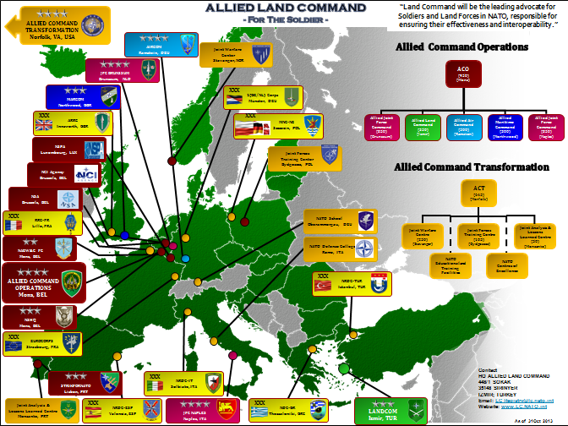
NATO STRUCTURE

Slide 22
NATO LL Structure
LL PROCESS
HQ SACT: lead for NATO LL process
SHAPE: has the lead for the output of the NATO LL process from OPS
LL CAPABILITY support
JALLC: providing analysis, expertise to operations or training
JWC + JFTC: through recording, implementing disseminating LL products from training and experimentation, exercises and doctrine development.
COE: as SME, provide unique capabilities
Other NATO Organizations
to establish individual LL capabilities aligned with the NATO LL Policy
83
Notes:
We receive or can get directions/instructions or support of different stakeholders, like:
HQ Supreme Allied Commander Transformation (SACT) Bilateral-Strategic Command as lead for NATO LL process
Allied Command Operations (ACO / SHAPE): as lead for the output of the NATO LLs process from operations
Joint Analysis and Lessons Learned Centre [JALCC] : as support for the LL capability providing analysis, expertise to operations or training and data storage as well
JWC (JFTC): as support for the LL capability through recording, implementing disseminating LL products from training and experimentation, exercises and doctrine development.
But also with the 23 COE which provide unique capabilities that NATO doesn’t have
And, of course, every NATO organisation has to establish individual LL capabilities aligned with the NATO LL Policy.

Slide 23
AGENDA
1. LL capability
LL process
LL tools
LL structure
LL training

Slide 24


Training
Courses
NATO Lessons Learned Staff Officer Course
NATO OPR Lessons Learned Course (ADL)
JALLC Analyst Training Course (JATC)
NATO Mobile Training Teams
  Alternative Analysis Course (NSO)
Handbooks
Joint Analysis Handbook – 3rd Edition
NATO LL Handbook – 2nd Edition
Bi-SC Alternative Analysis Handbook
Notes:
24

Slide 25
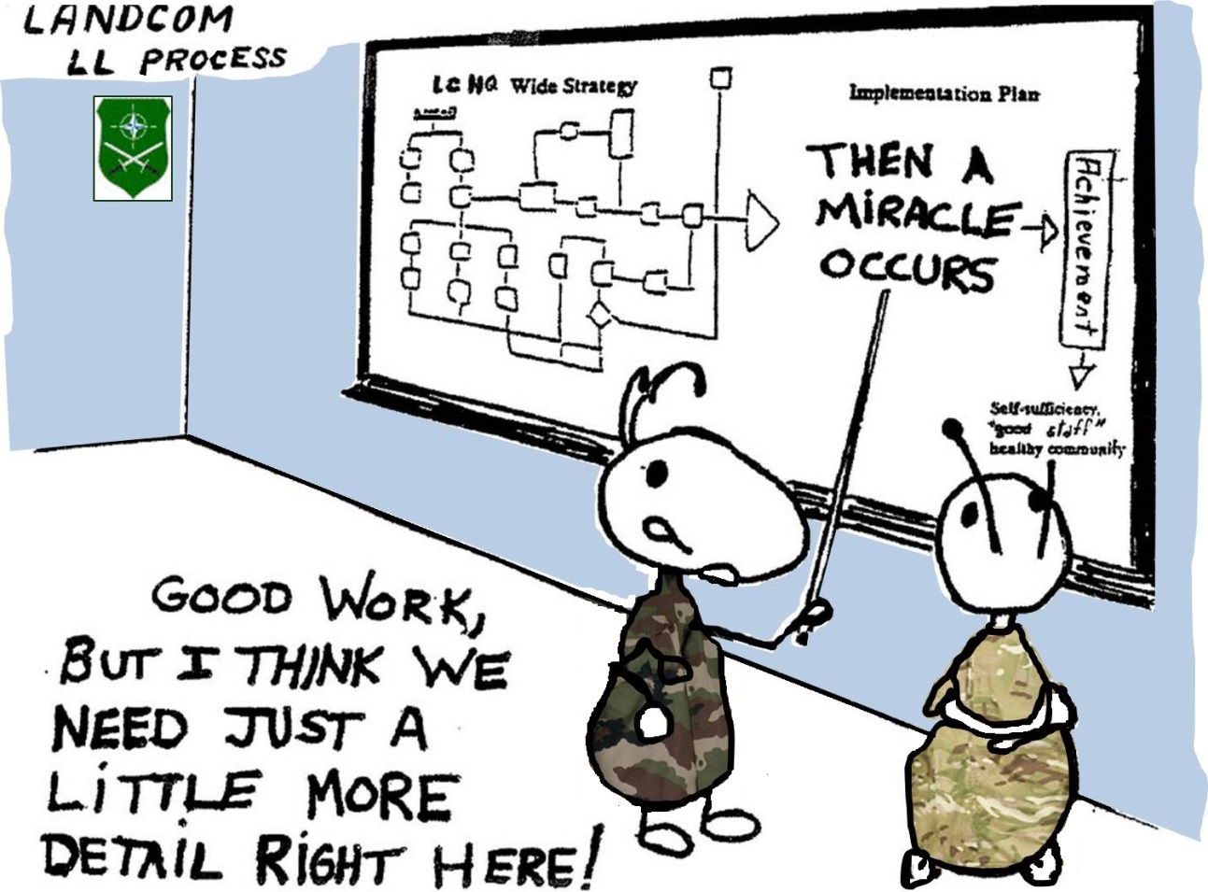
QUESTIONS
Everything you need to know about Lessons Learned in LANDCOM
SOP G7-006 LESSONS LEARNED

