Slide 1
NATO LESSONS LEARNED PORTAL
Overall classification is NATO UNCLASSIFIED – RELEASEABLE TO eFP
Major John Landers, USA A
HQ Allied Land Command, G7
Lessons Learned

Slide 2
NLLP Overview
History and Functionalities
NS vs NU
Main Library
Search for information and Contribute
LL Network
Other LL activities
Notes:
The lecture will be given through the following topics:
History and functionalities
NATO Secret versus NATO Unclassified
Main Library
Communities of interest
Search for information and contribute
Lessons Learned Network and
Other Lessons Learned activities

Slide 3
NATO LL Portal History
2005: NATO LL Database (NS)
2006: NATO LL Database (NU)
2016-17: SharePoint Migration
2013: NATO LL Portal (NS & NU)
2010: NATO LL Prototype Portals (NS & NU)
Notes:
JALLC was founded in September 2002, officially opened in December 2002.
In 2003 was developed a small software package named OCP (Observation Collection Program) basically to collect Observations with a specific format but without any staffing process.
At that time, even without any NATO Lessons Learned directive, the first steps towards the development of a Lessons Learned Database were done.
First in 2005 for NS and then in 2006 for NU, the first version of NATO Lessons Learned Database became fully operational. These happened more or less in same time when the first directives and policies were issued within NATO. The database comprised the staffing process: Observations, Lessons Identified and Lessons Learned. These data are submitted by users from across NATO.
2010: Portal Prototype was born from the apparent need for sharing lessons learned within and outside the Lessons Learned Community, among the NATO nations, Partnership for Peace countries and other partners.
2012: The new NLLP prototype was developed and launched.
July 2013: First version of the NATO LL Portal was released merging together the NATO LL Db and the NLLP prototype in one single platform based on SharePoint technology – The NLLP.
Beginning in 2017, we are in the process of migration from Share Point 2007 to 2013 and some other updates which will affect the Portal.
We are looking to the next step in facilitating the user access to all NLLP resources and to centralize all LL related information in one single tool – NLLP.

Slide 4
One Portal, Two Networks
SPOT THE DIFFERENCE
NLLP on the NATO UNCLASSIFIED network
  Accessible from internet: https://nllp.jallc.nato.int after registration
  Intended use: only for sharing
  Target users: NATO entities, NATO nations, Partner nations (*) and IOs/NGOs (*)
  Up to NATO UNCLASSIFIED information
  (*) Certain conditions apply.
NLLP on the NATO SECRET network
  Accessible from the NATO SECRET WAN
  Intended use: sharing & staffing
  Target users: NATO entities and NATO nations
  Up to NATO SECRET information
Notes:
Basically we can say that this is one portal placed on two networks.
NLLP on the Unclassified network is accessible from the internet after the registration and is intended for sharing. Target users on NU NLLP are NATO entities, NATO nations, Partner nations and IOs/NGOs. This portal is allowed to exchange information up to NATO Unclassified.
NLLP on NS network is accessible only from NATO Secret WAN and in this network we have two different type of users: Inside AIS (Automated Information System) domain (NCS) and Outside of AIS Domain (IS, IMS, NATO Nations, HFS, COEs, etc.). This portal is primarily used for sharing and staffing. The target users are NATO entities and NATO Nations. This portal allowing us to upload information up to NATO Secret classification.

Slide 5
One Portal, Two Networks
SPOT THE DIFFERENCE
NATO SECRET NLLP
NATO UNCLASSIFIED NLLP
https://nllp.jallc.nato.int* - EXT
https://nllp.jallc.nato.int
http://nllp.jallc.nato.int* - AIS
LL Staffing / Tracking Area + Sharing Area
Sharing Area only
Communities of Interest
Communities of Interest
Notes:
As I said during the presentation we have one NLL Portal but two version of it.
This slide will help you to understand the difference between this two versions: unclassified and classified.
Is not only a matter of classification, major differences’ is that NU NLLP is only a sharing tool, while NS NLLP is also an staffing tool.

Slide 6
NLLP Resources and Functionalities
1.
2.
3.
4.
NLLP LIBRARY
COI Libraries
NLLP Pages
Networking
Reports
Lessons
Best Practices
Factsheets
Open access documents
Limited access documents
LL activities
LL WG & COEs LL WS
Search Centre
-LL Network
-Calendar
-Events
Notes:
Talking about NLLP on both networks the NLLP Resources and Functionalities are:
NLLP Library where we can find Reports, Lessons, Best Practices, Factsheets and all other documents minutes/reports and other general information related to Lessons Learned
COI Libraries containing documents with open or limited access. Each document in a COI Library can be accessible through the main library or through the COI specific Library. Controlled by COI Administrator.
NLLP pages where we can find information related to different LL activities as LL Working groups and COE LL workshops, announcement and news. On this pages we also can find LL related information from the closed HQs (LL Legacy page).
Networking Functionalities which are mainly related to networking and events management. We can find all the information related to NLL Conference, JA Projects, training and courses, etc., and very important we can find all the POC information. Each point of contact within the LL Network acts as a focal point to address Lessons Learned issues. This network includes NATO entities, NATO member Nations, Partner Nations and Troop Contributing Nations for NATO led Operations.

Slide 7
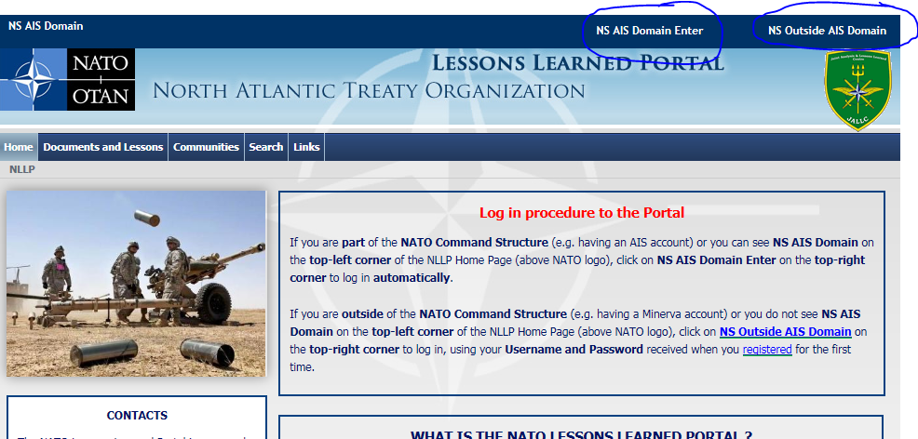
NS Access Requirements
NS AIS Domain users
NS Outside AIS Domain users

Slide 8
NS Access Requirements
In accordance with Bi-SCD 080-006 (Annex E)
Personnel from NCS, NFS and NATO Nations:
  Users from Automated Information System (AIS) domain will be automaticaly signed in
  Users outside of AIS domain only need to apply and provide a valid official e-mail address
  Access granted for three years or EOT date (whichever comes first)
Notes:
In the next couple of slides I will present you some information regarding the NS NLLP.
In order to be able to have benefits from NLLP you must become a NLLP user.
In accordance with BI-SC Directive 080-006 Annex E there is perquisite that you must fulfil in order to become the NLLP user.
Personnel from NATO structure will be automatically “signed in” in the case that they are users from Automated Information System (AIS) Domain.
Users outside of AIS Domain from NATO structure or NATO nations need to apply and to provide valid official e-mail addresses. Access will be granted for three years period or estimated end of tour (EOT) date.

Slide 9
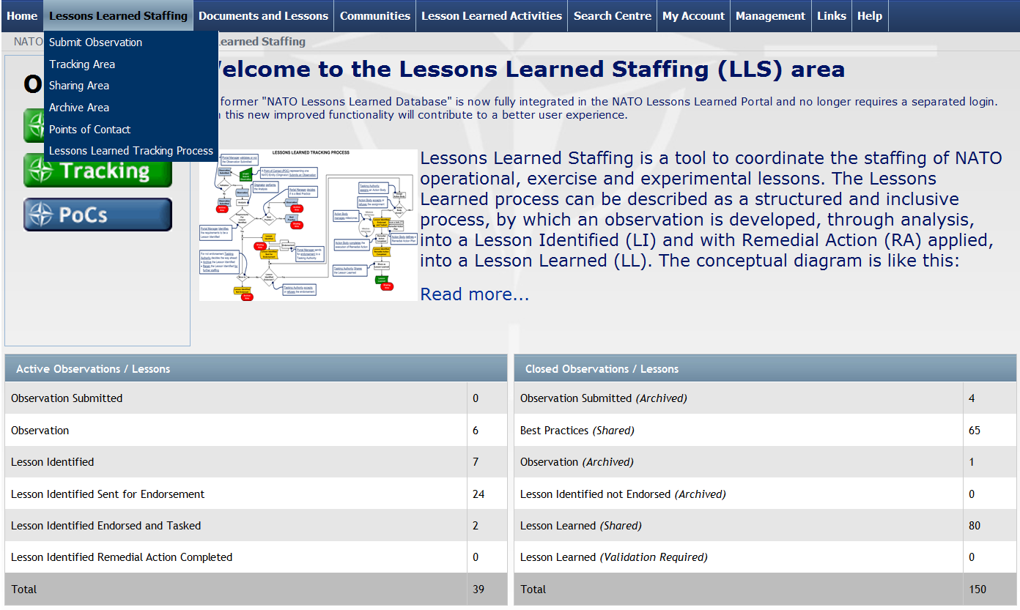
NS NLLP: The LL Staffing Area
Notes:
I would like to present 2 specific functionalities/features available on the NS only.
The first one is NATO LL Staffing Area.
This is the management tool, embedded in the NLLP, used by the NCS mainly for processes at Strategic/Operational level for staffing and tracking Observations and Lessons Identified of NATO interest through the LL Process (Bi-SCD 80-06).
It helps staff among different commands/org/offices/HQs to monitor the LL process. After an info is created as an observation or Lessons Identified and progresses to a Lessons Learned. (or archived)

Slide 10
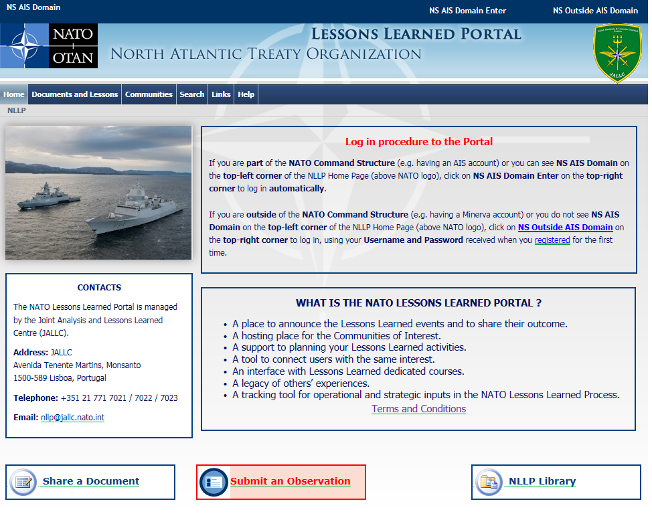
SUBMIT OBSERVATION

Slide 11
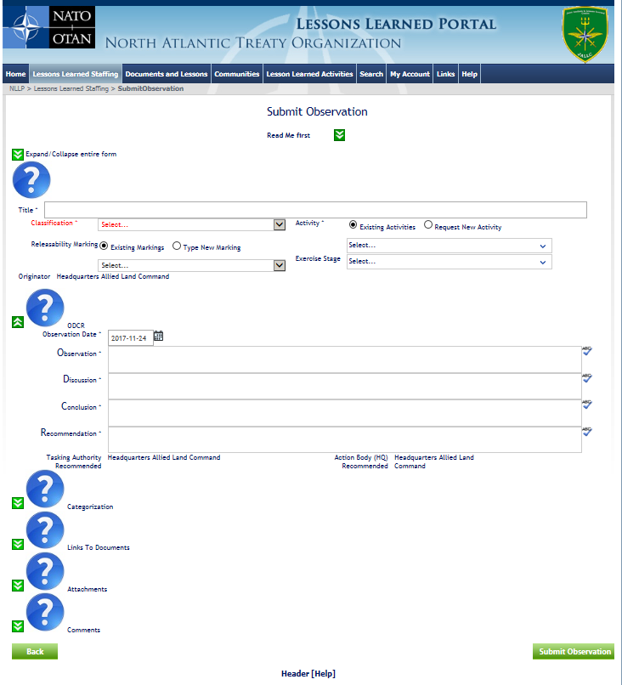
SUBMIT OBSERVATION

Slide 12
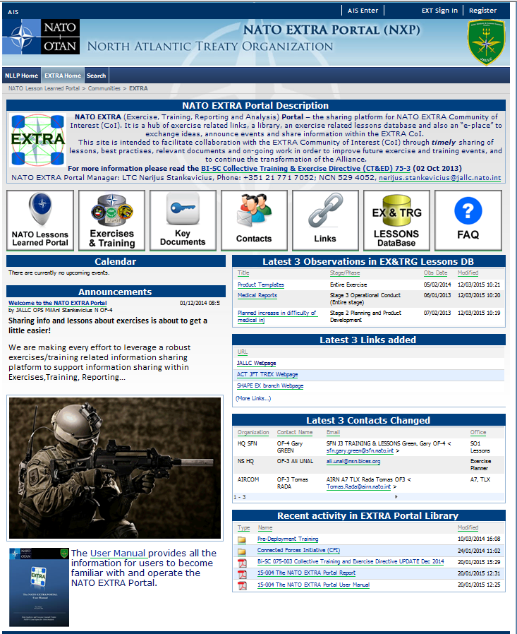
NS NLLP: The EXTRA Portal
EXTRA - EXercise, Training, Reporting and Analysis
NATO EXTRA Portal – the information sharing platform for NATO EXTRA Community of Interest (CoI). It is a hub of EX/TRN related links, a library, a database and an online forum board to exchange ideas, announce events and share information within the EXTRA CoI.
Notes:
The second function of NLLP on NS Network, is the NATO EXTRA Portal:
This is a NATO wide tool, available only on NATO Secret Network and is dedicated to Exercise, Training, Reporting and Analysis Community.
Here you have available all the documents from 2013 and ongoing NATO level exercises.
The EXTRA portal contains also links, calendar, POC information and key document.
The administration was recently transferred to HQ SACT Joint Force Trainer (JFT) while the JALLC is still responsible for the technical management.

Slide 13
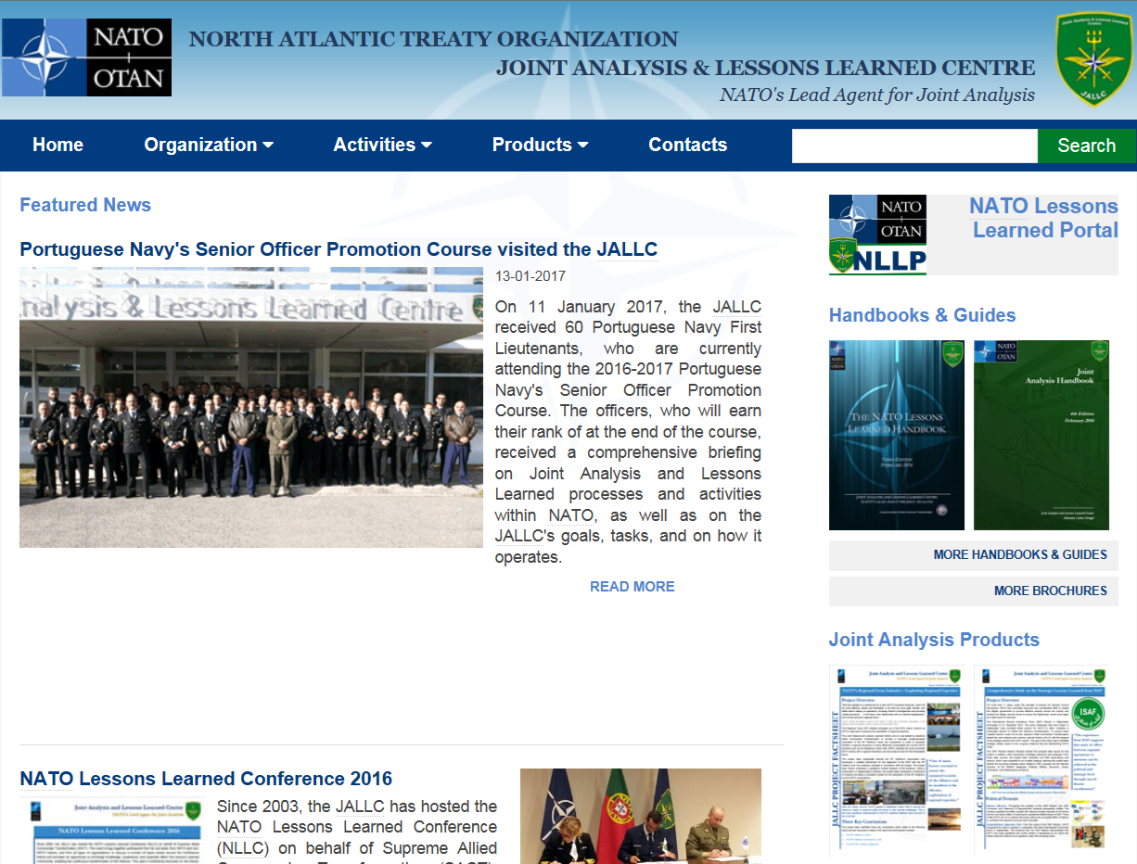
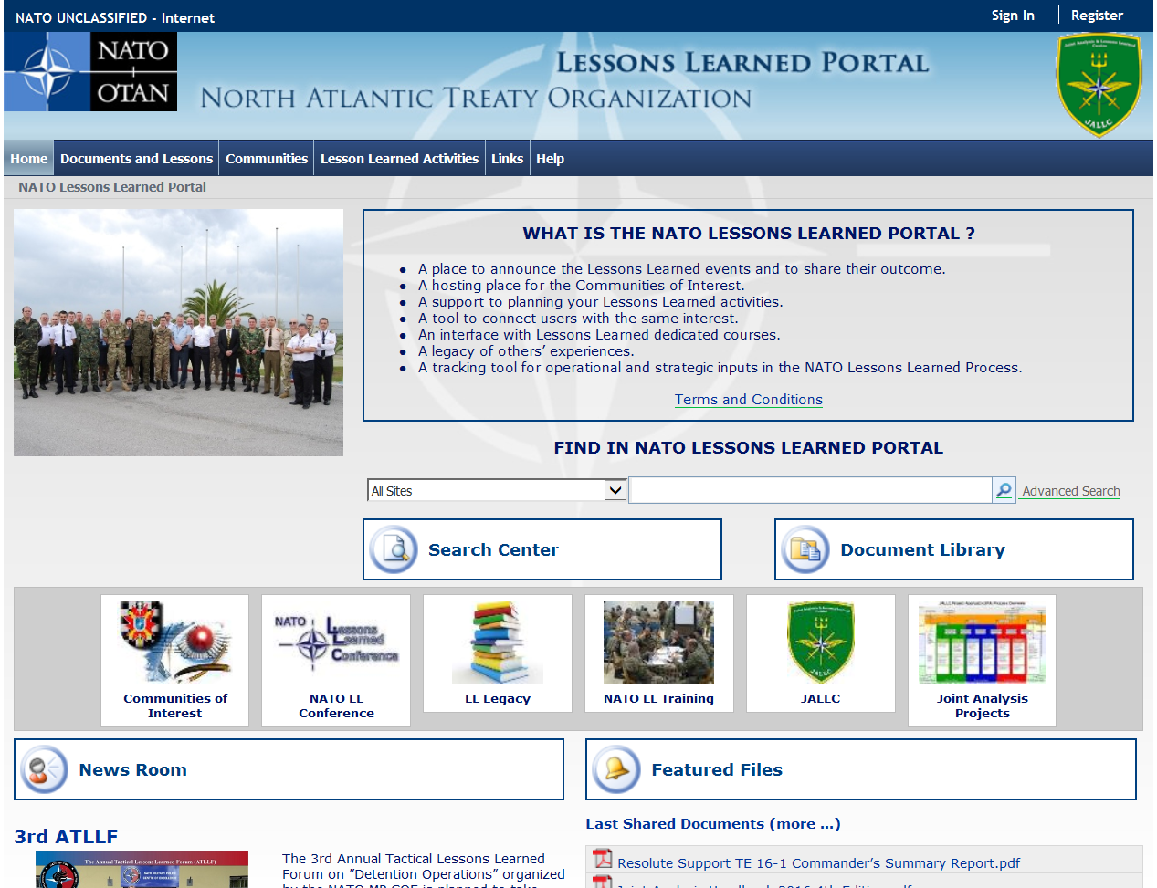
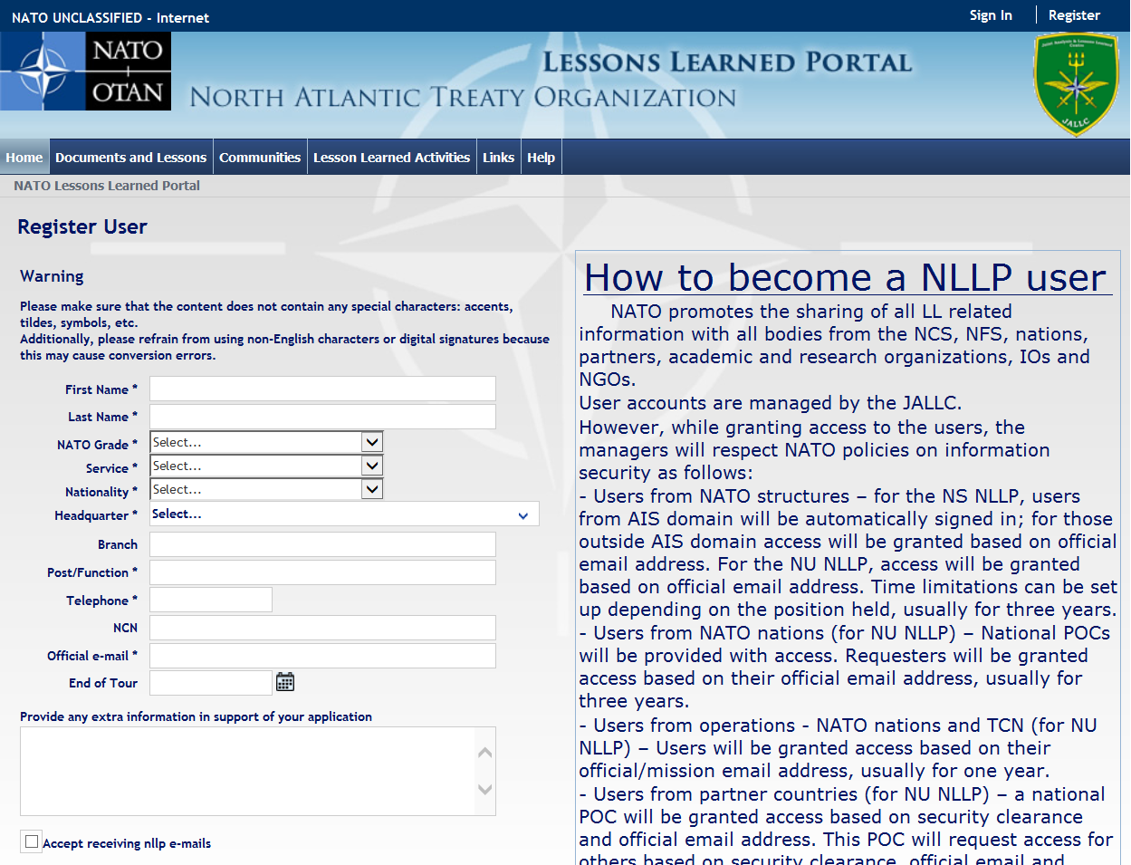
NU NLLP Access
https://nllp.jallc.nato.int
or via Google:
“NATO LL Portal”:
Notes:
In order to reach NLLP please use https://nllp.jallc.nato.int/ or search via Google: “ NATO LL Portal” for direct access.
Click on Register and fill up all requested information.
After this if you are fulfilling all predetermined conditions you will be granted access, if not NLLP manager will contact you via e-mail.
It is highly recommended to use Internet explorer browser in order to benefit all the possibility from NLLP.
With migration to new Share Point technology we hope that this will also improve and we will have possibility to use other browsers as well.

Slide 14
NU Access Requirements
In accordance with Bi-SCD 080-006 (Annex E)
Personnel from NCS, NFS and NATO Nations ions:
  Only need to apply and provide a valid official e-mail address
  Access granted for three years or EOT date (whichever comes first)
Personnel from Partner Nations:
  Sponsor required (to be appointed by the National MoD and communicated to JALLC)
  A valid official e-mail address and SC is required
  Access granted for two years
Personnel from IOs:
  Institutional POC required
  A valid official e-mail and SC address is required
  Access granted for one year
Notes:
Now in the following part of presentation I will focus on NLLP posted on NATO Unclassified network.
Just like for the NS NLLP and for NU NLLP in order to be able to have benefits you must become NLLP user.
In accordance with BI-SC Directive 080-006 Annex E you must fulfil predetermined conditions in order to become the NLLP user.
Personnel from NATO and NATO nations need to apply and to provide valid official e-mail addresses. Access will be granted for three years or estimated end of tour (EOT) date.
Personnel from Partner nations must have a sponsor which need to be appointed by the national Ministry of Defence. A valid Security Clearance and official e-mail addresses is required. Access is granted for period of two years.
Personnel from International Organizations must have a sponsor, institutional POC, with valid Security Clearance and official e-mail addresses. Access is granted for one year period.

Slide 15
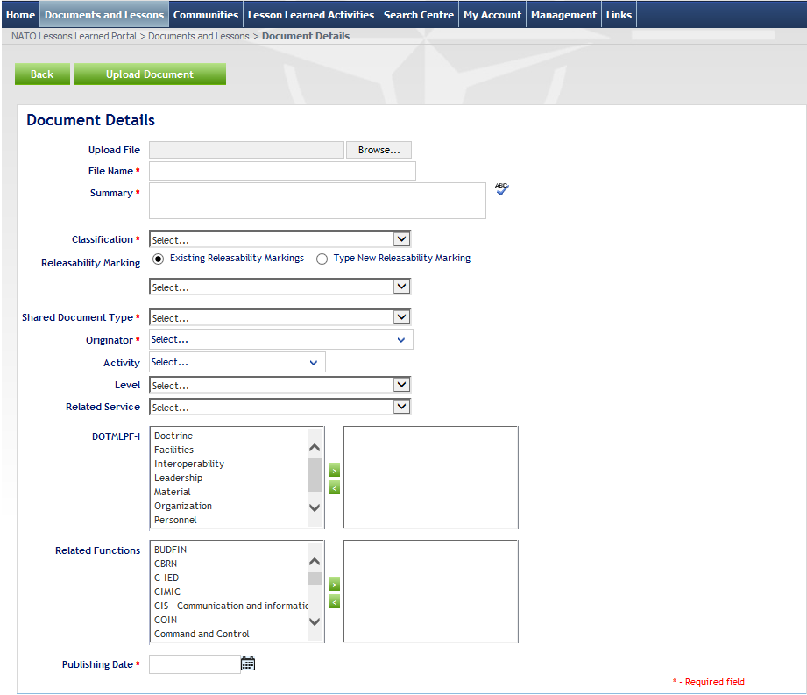
Metadata
Notes:
Talking about metadata of the documents which you would like to be published you need to pay special attention to:
File name = Title should match exactly the name of the document except for case (not of the electronic file).
Originator = Nation or IO under whose authority info has been produced (author).
Publishing date = Publication date of the document by the Originator and NOT the date that document is uploaded in the NLLP.
Corresponding to key metadata to filter information. Not all are required but they are the key to find info. (see green square)

Slide 16
Contributions Are Welcome!
We publish:
Policies
Directives
Handbooks
Newsletters
Factsheets
Institutional sponsored studies
Reports
Other LL related documents/publications
LI/LL/BP
Links to operational and tactical LLDbs
Links to other LL organizations
We do not publish:
Personal opinions
Personal (not sponsored) studies
Journal or magazine excerpts/articles
Observations
LIs and LLs with local and/or temporary value
Policies
Notes:
Once more just to remind you that we are publishing:
Policies, Directives, Handbooks, ….
And we are not publishing:
- Personal opinions, Personal studies, Journal or magazine articles or excerpts ….

Slide 17
Communities of Interest
Characteristics:
  Include more than one organization
  Common interest in sharing (specific areas of knowledge)
  Created under a formal agreement (Terms of Reference)
  Self-administrated (by appointed manager)
  Ideally a COE or NATO WG type entity
What NLLP can provide:
  Customized working space
  Dedicated library
  List of contacts
  Newsroom (to announce future and past events)
  Links
  Calendar
Notes:
As is stated on previous slide the LL COI Area is a specific website on the NLLP.
This created area is managed by an Administrator who manages information and access to that info.
Appointed administrator form COI is responsible for administrative process;
validation of documents uploaded in the main library;
serves as main PoC (update/change);
settings/changes of the different areas.
NLLP will provide: Customized working space, Dedicated library, List of contacts, Newsroom (to announce future and past events), Links and Calendar.
LANDCOM Administers:
eFP LL CoI, and the GRF(L) CoI

Slide 18
Questions
nllp@jallc.nato.int – technical and admin support portal related
jatt@jallc.nato.int – support for training on “NATO LL Process”
llnetwork@jallc.nato.int – all other LL related issue
Notes:
And at the end just to remind you that portal is just a tool, requiring users to share and to suggest improvements.
But sharing is not learning.
Sharing tools by themselves do not change anything.
Information has to be exploited and must drive a change to be considered as learned.
NATO LL PORTAL IS A KEY FOR SOME OF YOUR CONCERNS; JUST USE IT

